Slide 1
Welcome to DevOpsDC!
6:30 - 7:00: Meet, greet, and eat!
7:00 - 7:15: Intros and Announcements
7:15 - 8:45: Presentations
Performance Testing Should be Free with DevOps!
8:45 - 9:00: Networking

Slide 2


Sponsors

Slide 3
Code of Conduct
http://www.meetup.com/DevOpsDC/pages/Code_of_Conduct/
We value the participation of each member of the community and want all attendees to have an enjoyable and fulfilling experience. Accordingly, all attendees are expected to show respect and courtesy to other attendees throughout all Meetup events.
To make clear what is expected, all delegates/attendees, speakers, exhibitors, organizers, and volunteers at any DevOpsDC event are required to conform to our Code of Conduct. Organizers will enforce this code throughout events.

Slide 4
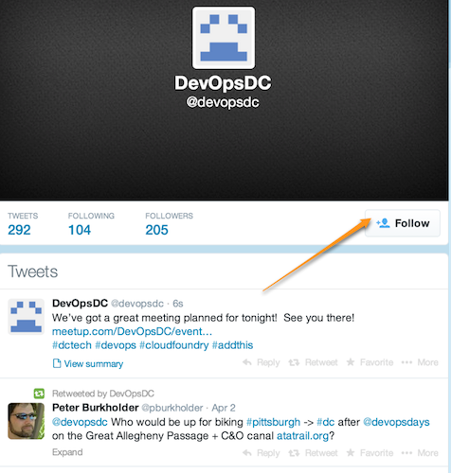
Do you even tweet?
https://twitter.com/devopsdc

Slide 5
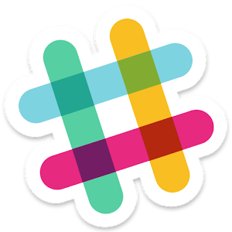
Slackin'…
http://www.dctechslack.com

Slide 6
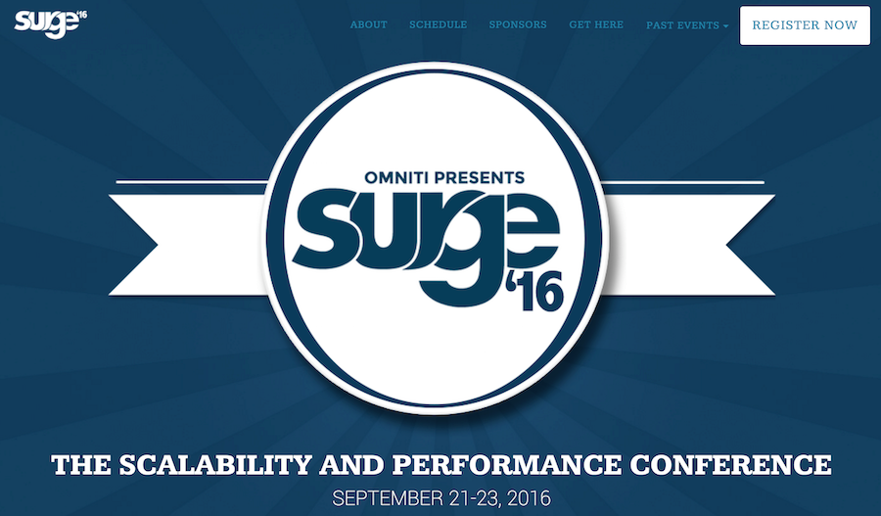
Free One-day Workshop: Introduction to Application Automation with Habitat
https://surge.omniti.com/2016
Notes:
Ticket Price - $750

Slide 7
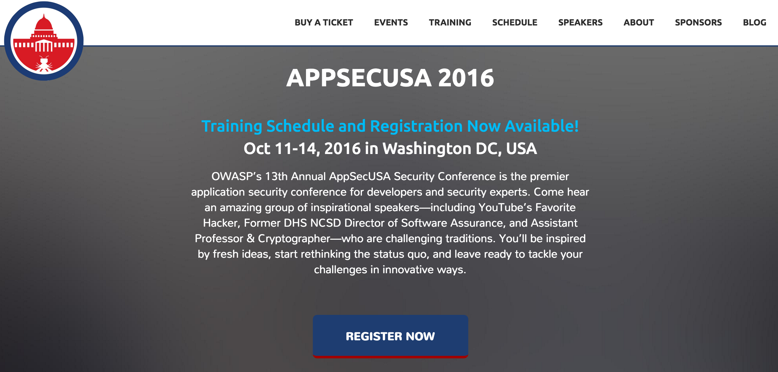
Notes:
https://2016.appsecusa.org/

Slide 8
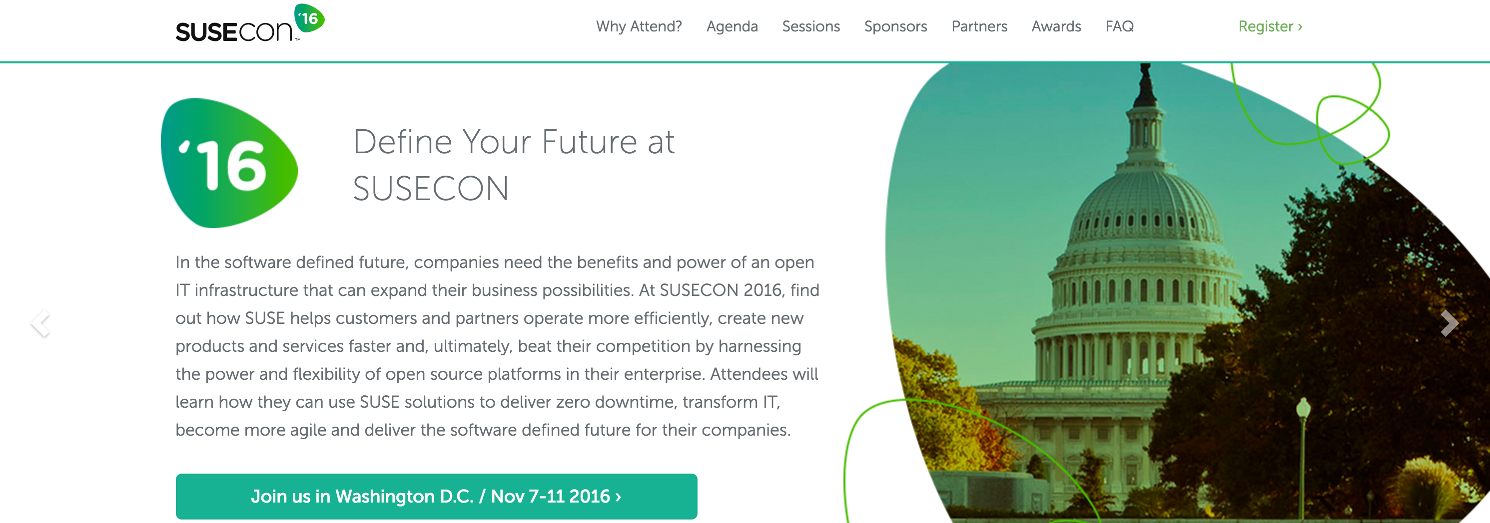
Notes:
http://www.susecon.com/

Slide 9

DevOpsDays Baltimore
March 7 & 8, 2017
http://www.devopsdays.org/events/2017-baltimore/welcome/

Slide 10
Upcoming Meetups
September 13 - Excella Consulting, Laura Barton & ??
October 11 - Optoro, Analytics for DevOps & Something to do with security
November 8 - Excella Consulting, Tony Alletag & ??
December 13 - Excella Consulting, Mark Cornick && ??
Notes:
October: AppSec USA is in town, our meetup will be walking distance from the conference.
Seeking one other presenter for September, November, and December

Slide 11
Now it's your turn…
Hiring?
Looking for work?
Attending or speaking at a conference?
Something we all should know?
Favorite color?

